Slide 1

Proposal for
JOBSTREET Philippines
About Accuracy
Executive Summary
Requirements
Solution
Technical Architecture
Price
Support & Maintenance
Training
Notes:
At A Glance
Accuracy products addresses Analytics in various areas without deviating Customers from current Data warehousing, BI solutions investment with a seamless API integration with the value of Analytics, AI embedded into any existing applications.
Accuracy is progressing ahead of emerging trends like AI, Mobility, IoT, Big Data and Cloud in its specialization.
Three Main Sections of Accuracy Products and Services:
Data and AI Products – these are products that Accuracy re-sells from our partner data and AI product providers,
Data and AI Services such as Data Consulting, Database Migrations, DWH/MDM/BI, Advanced Analytics, Big Data and Artificial Intelligence,
Resource Augmentation – Accuracy provides you the experts for over 40 data technologies, Data and AI Resources, APJ Coverage and Flexible T & M Models

Slide 2

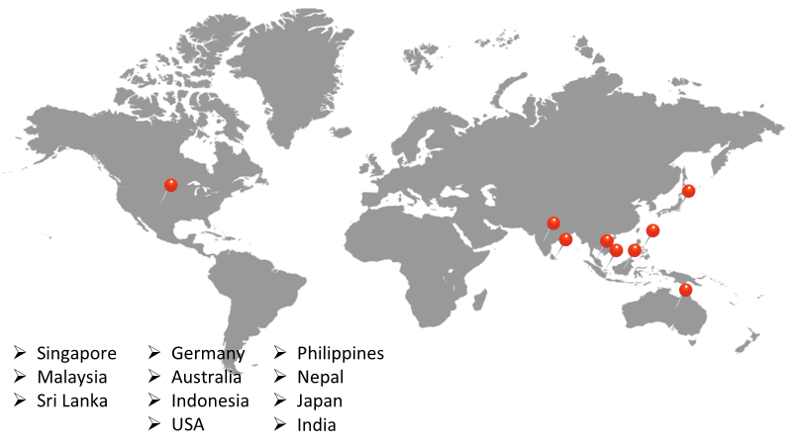
ABOUT ACCURACY
Accuracy is a Singapore Data & AI Company primarily focused on data Consulting, Product development, Services, and resourcing.
Partnerships with 20+ Data & AI product companies, 15+ domain experts and 10+ data providers, across the globe.
Serving across industrial verticals

Slide 3
EXECUTIVE SUMMARY
Jobstreet is the preferred online job portal by both candidates and companies seeking to fill vacancies.
One Jobstreet’s concerns is how to better serve their clients both internal and external, and one of the things that they are currently looking at is accounts matching.
Accuracy is please to submit a proposal for data matching.

Slide 4
REQUIREMENTS
Data Matching:
How to identify unique and duplicate job posting
How to eliminate multiple job posting
How to qualify job postings as unique or duplicate when recruiter indicated a different designation or title

Slide 5
SOLUTION
To solve the above problems Accuracy team found a solution using matching algorithm
Using SQL functions we got Unique and Duplicate records from the original dataset.
To eliminate the multiple job postings we used String functions in SQL
We applied the matching logic on designation/title/Job ad to identify the job postings as unique or duplicate.

Slide 6
TECHNICAL ARCHITECTURE
SOURCE DATA
DESTINATION
RESULTS
IMPORTING DATA
DATABASE SERVER
EXCEL
IMPORTING DATA
UNIQUE RESULTS
ALGORITHM FOR UNIQUE VALUES
SQL SERVER
IMPORTING DATA
ALGORITHM FOR DUPLICATE VALUES
DUPLICATE RESULTS
MYSQL SERVER
Notes:
At A Glance
Accuracy products addresses Analytics in various areas without deviating Customers from current Data warehousing, BI solutions investment with a seamless API integration with the value of Analytics, AI embedded into any existing applications.
Accuracy is progressing ahead of emerging trends like AI, Mobility, IoT, Big Data and Cloud in its specialization.
Three Main Sections of Accuracy Products and Services:
Data and AI Products – these are products that Accuracy re-sells from our partner data and AI product providers,
Data and AI Services such as Data Consulting, Database Migrations, DWH/MDM/BI, Advanced Analytics, Big Data and Artificial Intelligence,
Resource Augmentation – Accuracy provides you the experts for over 40 data technologies, Data and AI Resources, APJ Coverage and Flexible T & M Models

Slide 7
PRICE
Notes:
At A Glance
Accuracy products addresses Analytics in various areas without deviating Customers from current Data warehousing, BI solutions investment with a seamless API integration with the value of Analytics, AI embedded into any existing applications.
Accuracy is progressing ahead of emerging trends like AI, Mobility, IoT, Big Data and Cloud in its specialization.
Three Main Sections of Accuracy Products and Services:
Data and AI Products – these are products that Accuracy re-sells from our partner data and AI product providers,
Data and AI Services such as Data Consulting, Database Migrations, DWH/MDM/BI, Advanced Analytics, Big Data and Artificial Intelligence,
Resource Augmentation – Accuracy provides you the experts for over 40 data technologies, Data and AI Resources, APJ Coverage and Flexible T & M Models

Slide 8
training
Accuracy will provide following two trainings along with Product principal after installation of Software.
Training | Particulars | Sessions | Pax | Details
Admin Training | Admin Manual | 1 | 2 | Admin training includes job deployment, monitoring, basic trouble shooting Server & Cluster maintenance HA/DR switching User folder maintenance
Application Training | User Manual | 1 | 10 | Basic training includes IDE environment, Software usage best practices, modeling, Security, deploying and scheduling.
Notes:
At A Glance
Accuracy products addresses Analytics in various areas without deviating Customers from current Data warehousing, BI solutions investment with a seamless API integration with the value of Analytics, AI embedded into any existing applications.
Accuracy is progressing ahead of emerging trends like AI, Mobility, IoT, Big Data and Cloud in its specialization.
Three Main Sections of Accuracy Products and Services:
Data and AI Products – these are products that Accuracy re-sells from our partner data and AI product providers,
Data and AI Services such as Data Consulting, Database Migrations, DWH/MDM/BI, Advanced Analytics, Big Data and Artificial Intelligence,
Resource Augmentation – Accuracy provides you the experts for over 40 data technologies, Data and AI Resources, APJ Coverage and Flexible T & M Models

Slide 9
ASSUMPTIONS
There is no software licenses required. Accuracy can leverage open source software for doing this work.
Additional scope beyond the scope of this proposal will be covered with a service request.
This is a SaaS Service, hence no Hardware or Software required
Customer will facilitate working with their Infra, Vendors and other third parties.
Customer should facilitate for all pre-requisites for installation.
Services should be in Manila location only.
All necessary logistics required to execute the project shall be provided by the Customer.
Security, hardening not covered in this scope.
Customer teams should commit to project plan schedules agreed for meetings, UAT etc. any delays due to this must be compensated by Customer.
It is assumed that customer resources are dedicated and available to work with Accuracy resources as per the project timeline
Accuracy’s resources and Accuracy’s subcontractors’ resources may perform services remotely or on-site from Accuracy facilities, Customer facilities, or Accuracy’s partner’s facilities
Notes:
At A Glance
Accuracy products addresses Analytics in various areas without deviating Customers from current Data warehousing, BI solutions investment with a seamless API integration with the value of Analytics, AI embedded into any existing applications.
Accuracy is progressing ahead of emerging trends like AI, Mobility, IoT, Big Data and Cloud in its specialization.
Three Main Sections of Accuracy Products and Services:
Data and AI Products – these are products that Accuracy re-sells from our partner data and AI product providers,
Data and AI Services such as Data Consulting, Database Migrations, DWH/MDM/BI, Advanced Analytics, Big Data and Artificial Intelligence,
Resource Augmentation – Accuracy provides you the experts for over 40 data technologies, Data and AI Resources, APJ Coverage and Flexible T & M Models

Slide 10

contact
AUDREY ANN LEE
BDM - PHILIPPINES
ACCURACY INC.
+639175008787
Notes:
At A Glance
Accuracy products addresses Analytics in various areas without deviating Customers from current Data warehousing, BI solutions investment with a seamless API integration with the value of Analytics, AI embedded into any existing applications.
Accuracy is progressing ahead of emerging trends like AI, Mobility, IoT, Big Data and Cloud in its specialization.
Three Main Sections of Accuracy Products and Services:
Data and AI Products – these are products that Accuracy re-sells from our partner data and AI product providers,
Data and AI Services such as Data Consulting, Database Migrations, DWH/MDM/BI, Advanced Analytics, Big Data and Artificial Intelligence,
Resource Augmentation – Accuracy provides you the experts for over 40 data technologies, Data and AI Resources, APJ Coverage and Flexible T & M Models

Slide 11

Notes:
At A Glance
Accuracy products addresses Analytics in various areas without deviating Customers from current Data warehousing, BI solutions investment with a seamless API integration with the value of Analytics, AI embedded into any existing applications.
Accuracy is progressing ahead of emerging trends like AI, Mobility, IoT, Big Data and Cloud in its specialization.
Three Main Sections of Accuracy Products and Services:
Data and AI Products – these are products that Accuracy re-sells from our partner data and AI product providers,
Data and AI Services such as Data Consulting, Database Migrations, DWH/MDM/BI, Advanced Analytics, Big Data and Artificial Intelligence,
Resource Augmentation – Accuracy provides you the experts for over 40 data technologies, Data and AI Resources, APJ Coverage and Flexible T & M Models

